Slide 1

Continuous Time Control of Tandem Production Lines
Mehmet Murat Fadıloğlu
Özge Büyükdağlı
Yaşar University, Izmir

Slide 2
Content
Introduction
Literature
The Models
  Basic Model
  Model with Breakdowns
Numerical Experiments

Slide 3
Introduction
We consider the problem of production control and stock rationing in a make-to-stock production system with several customer classes that generate independent Poisson demands.
We model the make-to-stock production system with
  A tandem production line with a finished goods buffer at the end
  Workstations with exponential production times and intermediate buffers
At decision epochs, we make
  the stock allocation decision for the finished goods and
  Production decision (continue or stop) at each workstation.

Slide 4
Introduction
A continuous-time Markov control problem
Via uniformization technique, the problem is transformed into a discrete-time dynamic program.
We would like to
  characterize the best production/inventory policies
  compare them with simpler/applicable policies
We also consider a variation of the basic model which incorporates breakdowns and repairs at the stations.

Slide 5
Literature
Veatch and Wein (1994) : first application of the optimal control paradigm to investigate production and inventory control in tandem lines.
  Theoretical properties of the two station problem and some numerical examples on the performance of the various pull mechanisms
Karaesmen and Dallery (2000) : performance evaluation of available pull mechanisms via mainly an experimental study.
  Close in spirit to our study
  No rationing
  Backordering environment (we use lost sales)
  We aim to consider a wider class of models (breakdowns, etc…)
  We emphasize managerial insights

Slide 6
Models
Basic Model
Model with Breakdowns

Slide 7








Basic Model
A production/inventory system with two workstations, an intermediate buffer between the workstations and an exit buffer in which the finished goods are kept.
Another customer
demand
$$x_{1}$$
$$x_{2}$$
customer
demand
Demand Arrival
$$μ_{1}$$
$$μ_{2}$$
$$λ$$
$$λ$$
infinite supply
Station 1
Station 2
Production at the first station
Production at the second station

Slide 8



Basic Model
State of the System
$$X\left(t\right)=(X_{1}\left(t\right), X_{2}\left(t\right))$$
where,
$X_{1}\left(t\right)$ : the intermediate items inventory at time $t$, (including the item in process at station 2)
$X_{2}\left(t\right)$ : the finished good inventory level at time $t$
$$x_{1}$$
$$x_{2}$$
Station 1
Station 2
WIP
FG

Slide 9



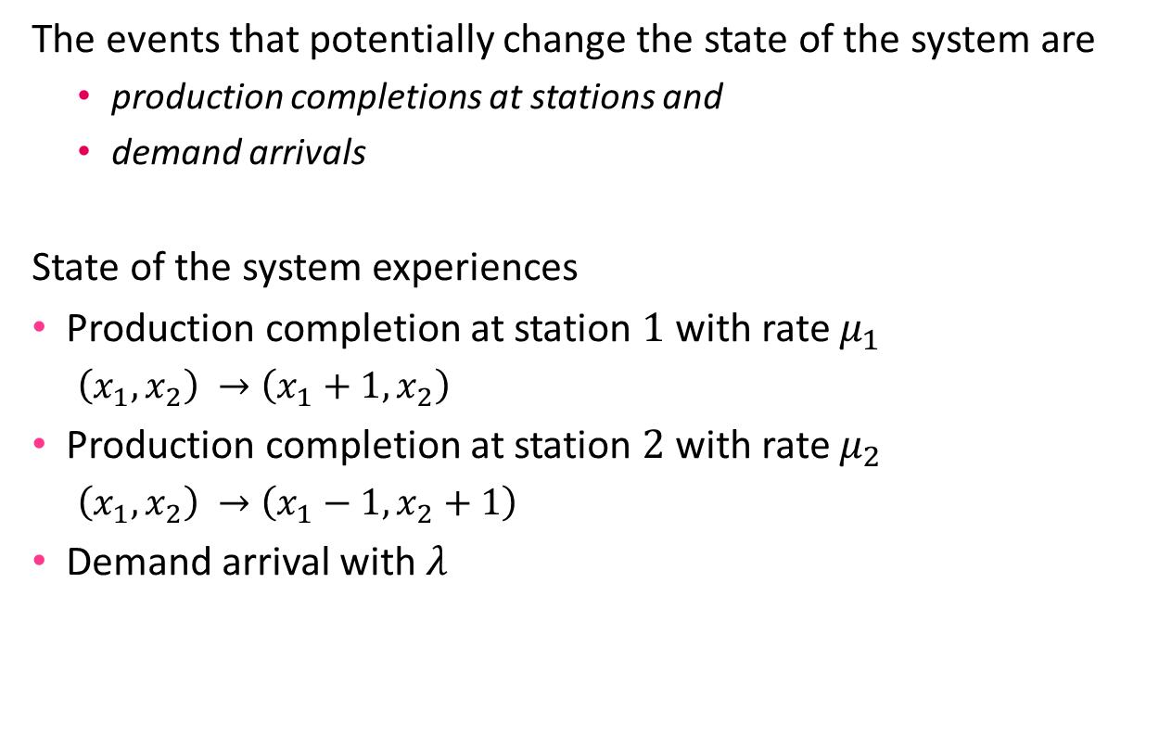
Basic Model
The Events
The events that potentially change the state of the system are
  production completions at stations and
  demand arrivals
State of the system experiences
Production completion at station $1$ with rate $μ_{1}$
  $\left(x_{1},x_{2}\right) →\left(x_{1}+1,x_{2}\right)$
Production completion at station $2$ with rate $μ_{2}$
  $\left(x_{1},x_{2}\right) →\left(x_{1}−1,x_{2}+1\right)$
Demand arrival with 𝜆
$\left(x_{1},x_{2}−1\right)$ when satisfied
$$\left(x_{1},x_{2}\right)$$
$\left(x_{1},x_{2}\right)$ when rejected

Slide 10
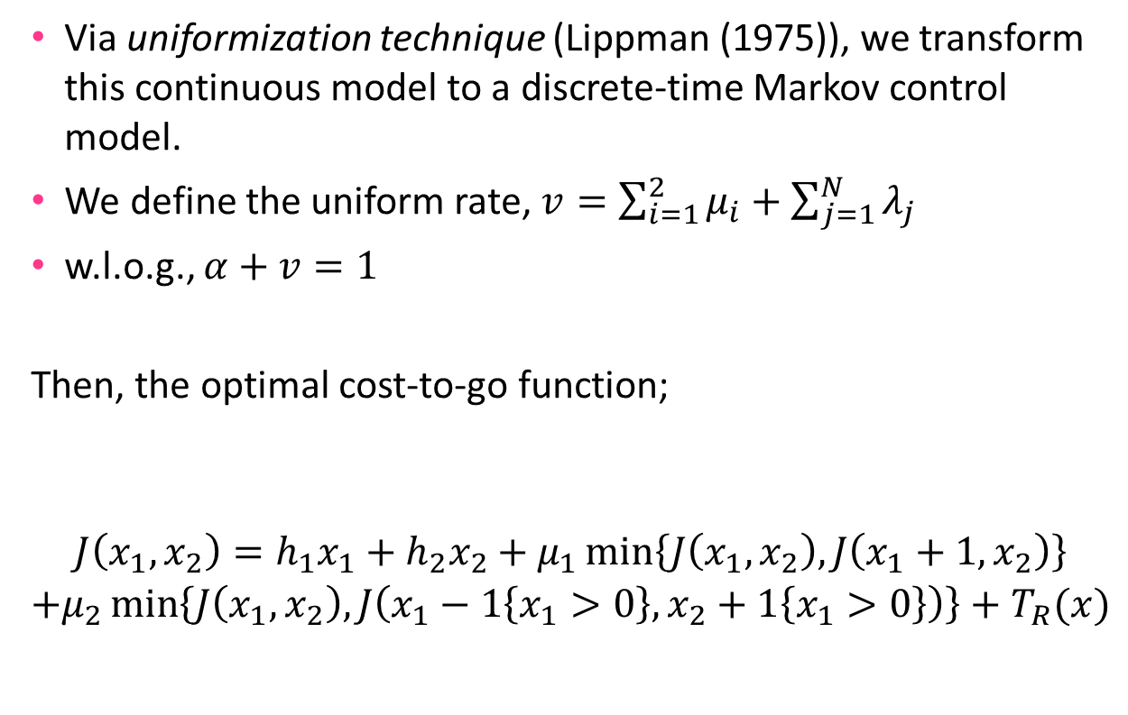
Basic Model
Via uniformization technique (Lippman (1975)), we transform this continuous model to a discrete-time Markov control model.
We define the uniform rate, $v=\sum_{i=1}^{2}{μ_{i}}+\sum_{j=1}^{N}{λ_{j}}$
w.l.o.g., $α+v=1$
Then, the optimal cost-to-go function;
$$\begin{matrix}J\left(x_{1},x_{2}\right)=h_{1}x_{1}+h_{2}x_{2}+μ_{1}\min\left\{J\left(x_{1},x_{2}\right),J\left(x_{1}+1,x_{2}\right)\right\} \\ +μ_{2}\min\left\{J\left(x_{1},x_{2}\right),J\left(x_{1}−1\left\{x_{1}>0\right\},x_{2}+1\left\{x_{1}>0\right\}\right)\right\}+T_{R}(x)\end{matrix}$$
Station 1
production decision
Holding Costs
Station 2
production decision
Rationing Decision

Slide 11
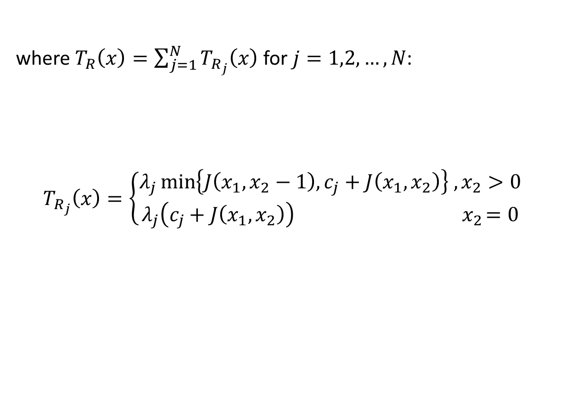
Basic Model
where $T_{R}\left(x\right)=\sum_{j=1}^{N}{T_{R_{j}}\left(x\right)}$ for $j=1,2,…,N$:
$$T_{R_{j}}\left(x\right)=\left\{\begin{aligned}λ_{j}\min\left\{J\left(x_{1},x_{2}−1\right),c_{j}+J\left(x_{1},x_{2}\right)\right\} ,x_{2}>0 \\ λ_{j}\left(c_{j}+J\left(x_{1},x_{2}\right)\right) { x}_{2}=0\end{aligned}\right.$$
Either to satisfy an arriving demand
Or reject…
No finished goods,
lost sales inevitable

Slide 12
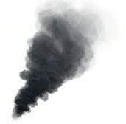






Model with Breakdowns
A variation on the basic model that allows random breakdowns and repairs at both stations
  The time to next breakdown $α_{i}\sim exp$
  For a station that is down, the time to repair $β_{i}\sim exp$
breakdown
breakdown
customer
demand
$$α_{1}$$
$$α_{2}$$
infinite supply
$$λ$$
Station 1
Station 2
$$β_{1}$$
$$β_{2}$$

Slide 13
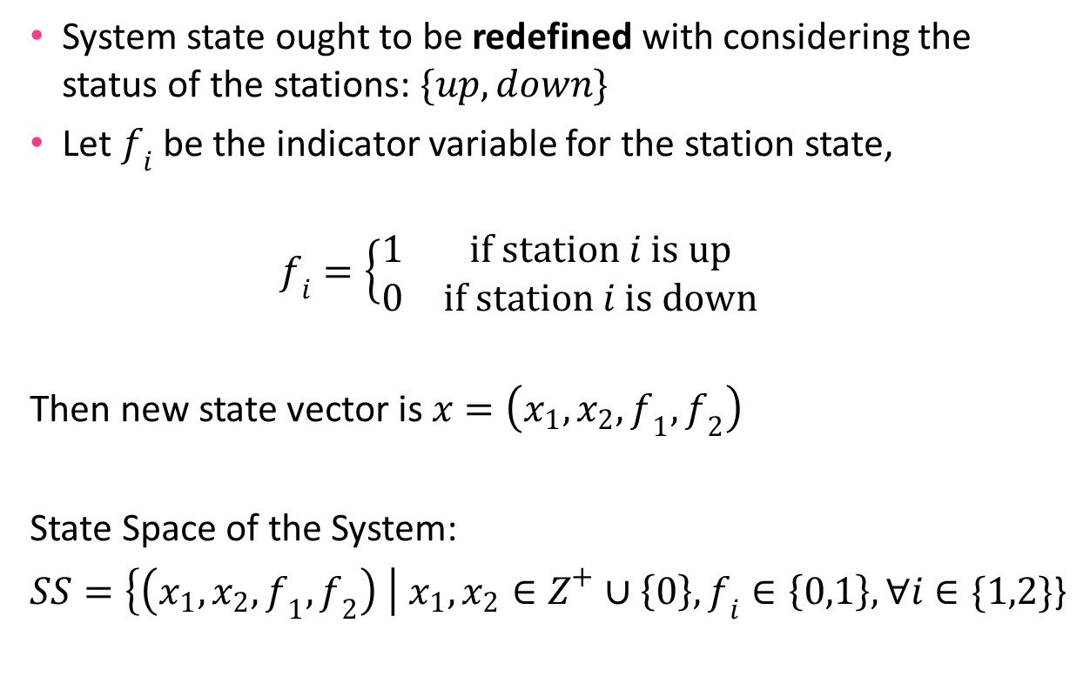
Model with Breakdowns
State of the System
System state ought to be redefined with considering the status of the stations: $\{up, down\}$
Let $f_{i}$ be the indicator variable for the station state,
$$f_{i}=\left\{\begin{matrix}1 & if station i is up \\ 0 & if station i is down\end{matrix}\begin{aligned} \\ \end{aligned}\right.$$
Then new state vector is $x=\left(x_{1},x_{2},f_{1},f_{2}\right)$
State Space of the System:
$SS=\left\{\left(x_{1},x_{2},f_{1},f_{2}\right) \right| x_{1},x_{2}∈Z^{+}∪\left\{0\right\},f_{i}∈\left\{0,1\right\}, ∀i∈\{1,2\}$}

Slide 14
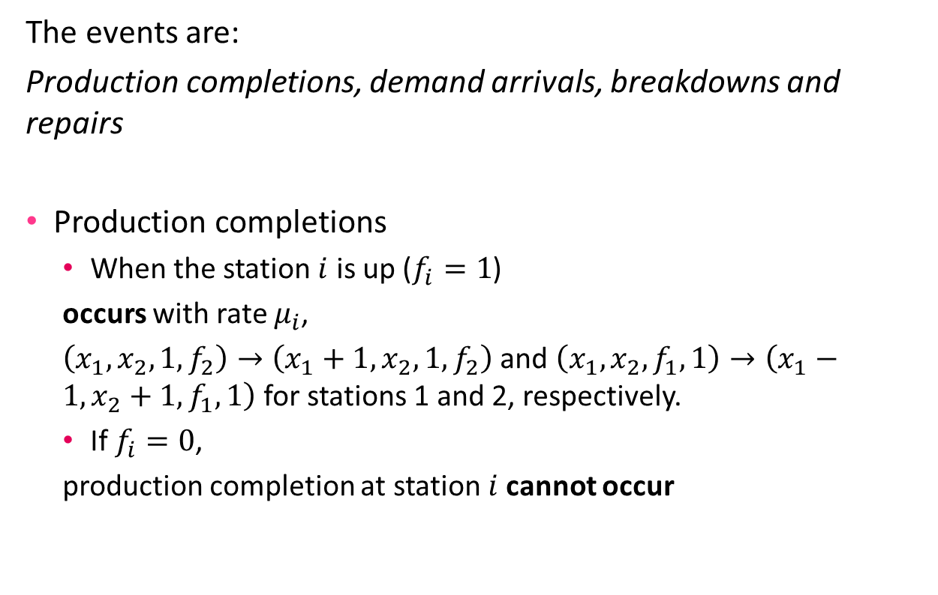
Model with Breakdowns
The Events
The events are:
Production completions, demand arrivals, breakdowns and repairs
Production completions
  When the station $i$ is up ($f_{i}=1$)
  occurs with rate $μ_{i}$,
  $\left(x_{1},x_{2},1,f_{2}\right)→\left(x_{1}+1,x_{2},1,f_{2}\right)$ and $\left(x_{1},x_{2},f_{1},1\right)→\left(x_{1}−1,x_{2}+1,f_{1},1\right)$ for stations 1 and 2, respectively.
  If $f_{i}=0$,
  production completion at station$i$cannot occur

Slide 15
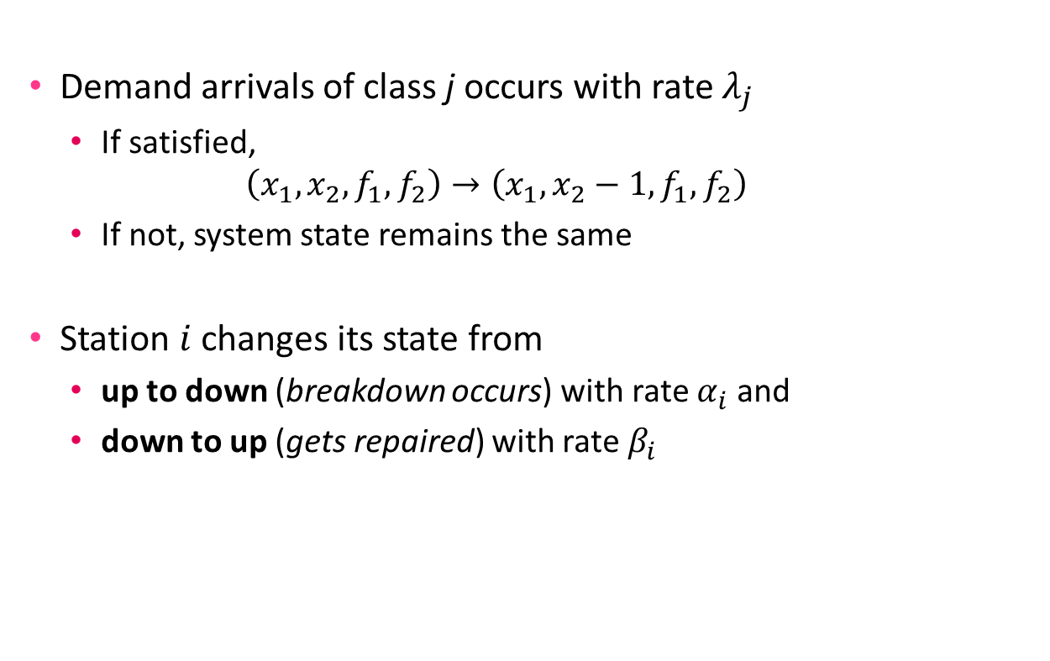
Model with Breakdowns
The Events
Demand arrivals of class j occurs with rate $λ_{j}$
  If satisfied,
  $$\left(x_{1},x_{2},f_{1},f_{2}\right)→\left(x_{1},x_{2}−1,f_{1},f_{2}\right)$$
  If not, system state remains the same
Station $i$ changes its state from
  up to down (breakdown occurs) with rate $α_{i}$ and
  down to up (gets repaired) with rate $β_{i}$

Slide 16
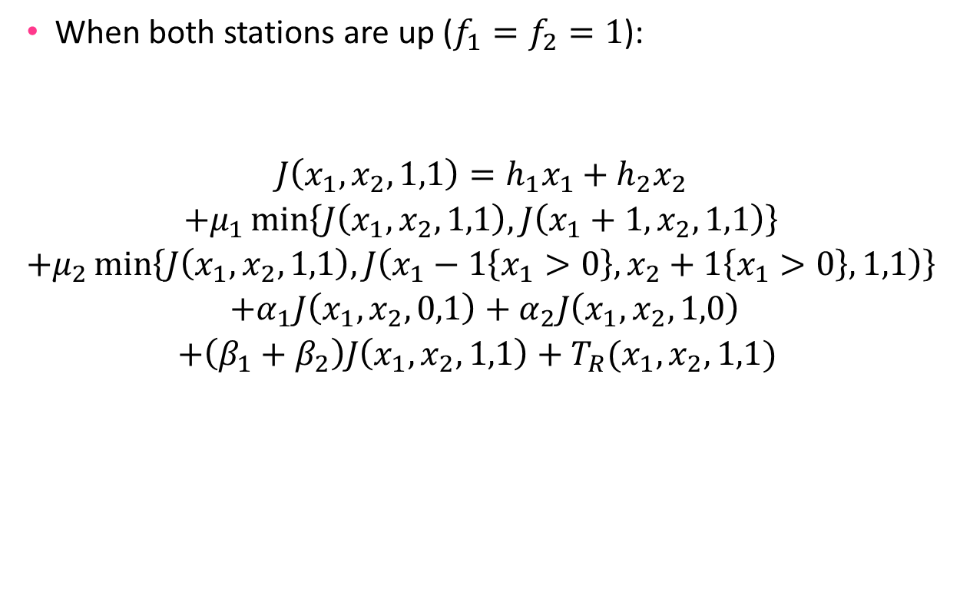
Model with Breakdowns
When both stations are up ($f_{1}=f_{2}=1$):
$$\begin{matrix}\begin{aligned}J\left(x_{1},x_{2},1,1\right)=h_{1}x_{1}+h_{2}x_{2} \\ +μ_{1}\min\left\{J\left(x_{1},x_{2},1,1\right),J\left(x_{1}+1,x_{2},1,1\right)\right\}\end{aligned} \\ +μ_{2}\min\left\{J\left(x_{1},x_{2},1,1\right),J\left(x_{1}−1\left\{x_{1}>0\right\},x_{2}+1\left\{x_{1}>0\right\},1,1\right)\right\} \\ \begin{aligned} +α_{1}J\left(x_{1},x_{2},0,1\right)+α_{2}J\left(x_{1},x_{2},1,0\right) \\ +\left(β_{1}+β_{2}\right)J\left(x_{1},x_{2},1,1\right)+T_{R}(x_{1},x_{2},1,1) \end{aligned}\end{matrix}$$
Holding Costs
Production decisions can be made
Breakdowns arrive
No repair occurs (self transition)
Rationing decision for a demand arrival

Slide 17
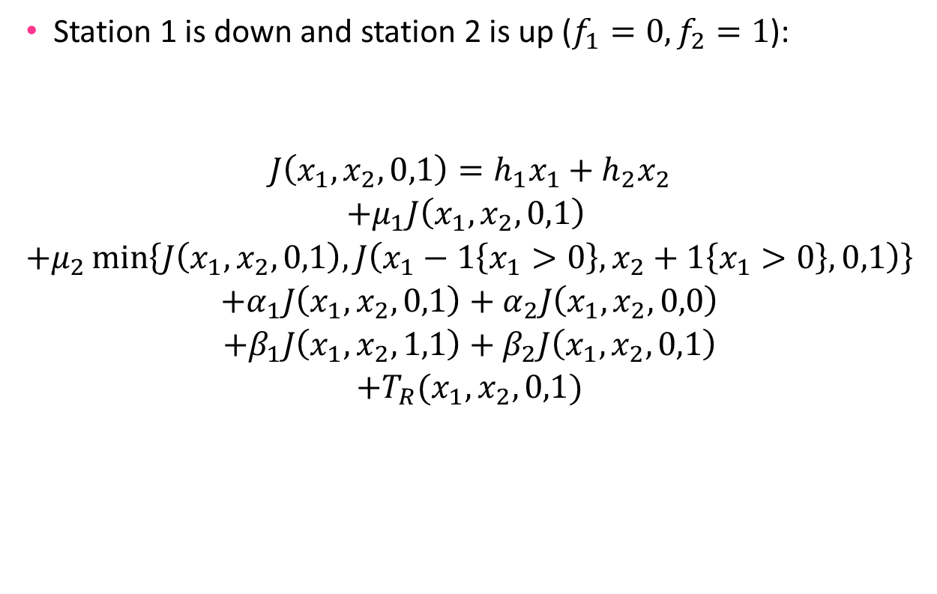
The Model with Breakdowns
Station 1 is down and station 2 is up ($f_{1}=0, f_{2}=1$):
$$\begin{matrix}\begin{aligned}J\left(x_{1},x_{2},0,1\right)=h_{1}x_{1}+h_{2}x_{2} \\ +μ_{1}J\left(x_{1},x_{2},0,1\right) \end{aligned} \\ +μ_{2}\min\left\{J\left(x_{1},x_{2},0,1\right),J\left(x_{1}−1\left\{x_{1}>0\right\},x_{2}+1\left\{x_{1}>0\right\},0,1\right)\right\} \\ \begin{aligned}+α_{1}J\left(x_{1},x_{2},0,1\right)+α_{2}J\left(x_{1},x_{2},0,0\right) \\ +β_{1}J\left(x_{1},x_{2},1,1\right)+β_{2}J\left(x_{1},x_{2},0,1\right)\end{aligned} \\ +T_{R}(x_{1},x_{2},0,1)\end{matrix}$$
No production decision can be made for down station (1)
Breakdowns still arrive for the up station (2),
Repair occurs for down station (1)

Slide 18

The Model with Breakdowns
Station 1 is up and station 2 is down ($f_{1}=1, f_{2}=0$)
$$\begin{matrix}\begin{aligned}J\left(x_{1},x_{2},1,0\right)=h_{1}x_{1}+h_{2}x_{2} \\ +μ_{1}\min\left\{J\left(x_{1},x_{2},1,0\right),J\left(x_{1}+1,x_{2},1,0\right)\right\}\end{aligned} \\ \begin{aligned}+μ_{2}J\left(x_{1},x_{2},1,0\right) \\ +α_{1}J\left(x_{1},x_{2},0,0\right)+α_{2}J\left(x_{1},x_{2},1,0\right)\end{aligned} \\ \begin{aligned}+β_{1}J\left(x_{1},x_{2},1,0\right)+β_{2}J\left(x_{1},x_{2},1,1\right) \\ +T_{R}(x_{1},x_{2},1,0)\end{aligned}\end{matrix}$$
Similarly…

Slide 19

The Model with Breakdowns
When both machines are down ($f_{1}=f_{2}=0$)
$$\begin{matrix}\begin{aligned}J\left(x_{1},x_{2},0,0\right)=h_{1}x_{1}+h_{2}x_{2} \\ +\left(μ_{1}+μ_{2}\right)J\left(x_{1},x_{2},0,0\right) \\ +\left(α_{1}+α_{2}\right)J\left(x_{1},x_{2},0,0\right)\end{aligned} \\ \begin{aligned}+β_{1}J\left(x_{1},x_{2},1,0\right)+β_{2}J\left(x_{1},x_{2},0,1\right) \\ +T_{R}(x_{1},x_{2},0,0)\end{aligned}\end{matrix}$$
Only breakdowns may occur in this case
Not much to decide…

Slide 20
Numerical Experiments
Optimal policies are obtained via a value iteration algorithm implemented on MATLAB.
We use the average cost criterion that is independent of the initial state.
This also allows us using steady-state analysis for evaluating other policies as well as the optimal policy.
Policy parameters for other policies are optimized via an exhaustive search over a reasonable subset of the parameter space.

Slide 21
Numerical Experiments
One-Step Transition Matrix
Value Iteration
Optimal Production Policy
Optimal Rationing Policy
Avg. Cost
Steady State Analysis
Setting
Production Policy
(CONWIP, Kanban etc. )
Rationing Policy
(Static, FCFS, etc. )
Avg. FG
Avg. WIP
Lost Sales Rate
Avg. Cost
Optimal Policy Parameters

Slide 22
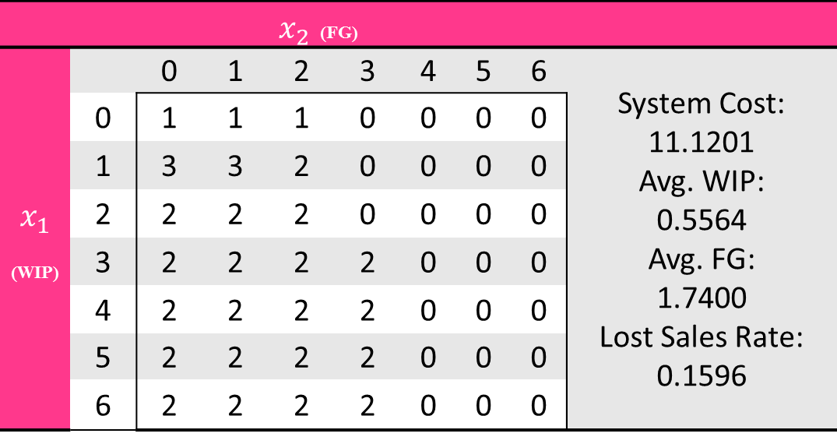



Numerical Experiments
Basic Model with No Rationing
$$x_{1}$$
$$x_{2}$$
S1
S2
WIP
FG
Produce at both
stations
Produce only at
station 2
We consider a system with parameters
$$\left(h_{1},h_{2},μ_{1},μ_{2},λ,c\right)=(2,3,2,2,1,30)$$
Produce only at
station 1
Busy Set
of
Station 1
 | $x_{2}$ (FG)
$$x_{1}$$ (WIP) |  | 0 | 1 | 2 | 3 | 4 | 5 | 6 | System Cost: 11.1201 Avg. WIP: 0.5564 Avg. FG: 1.7400 Lost Sales Rate: 0.1596
 | 0 | 1 | 1 | 1 | 0 | 0 | 0 | 0
 | 1 | 3 | 3 | 2 | 0 | 0 | 0 | 0
 | 2 | 2 | 2 | 2 | 0 | 0 | 0 | 0
 | 3 | 2 | 2 | 2 | 2 | 0 | 0 | 0
 | 4 | 2 | 2 | 2 | 2 | 0 | 0 | 0
 | 5 | 2 | 2 | 2 | 2 | 0 | 0 | 0
 | 6 | 2 | 2 | 2 | 2 | 0 | 0 | 0
However
most of
the states
are
transient
Busy Set
of
Station 2
Optimal production decisions for both stations

Slide 23
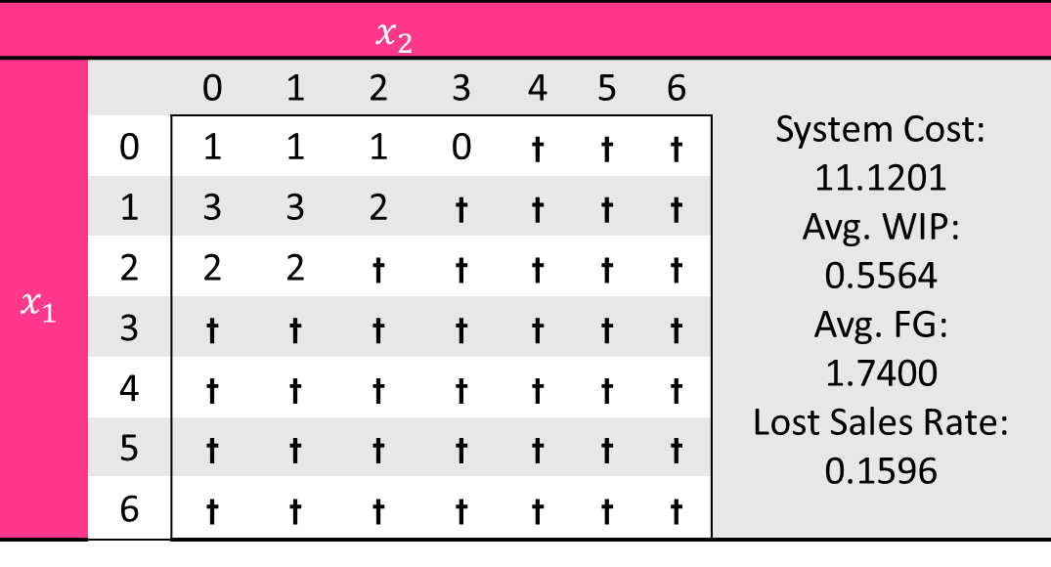
Numerical Experiments
Basic Model with No Rationing
$$x_{1}$$
$$x_{2}$$
S1
S2
WIP
FG
We consider a system with parameters
$$\left(h_{1},h_{2},μ_{1},μ_{2},λ,c\right)=(2,3,2,2,1,30)$$
 | $$x_{2}$$
$$x_{1}$$ |  | 0 | 1 | 2 | 3 | 4 | 5 | 6 | System Cost: 11.1201 Avg. WIP: 0.5564 Avg. FG: 1.7400 Lost Sales Rate: 0.1596
 | 0 | 1 | 1 | 1 | 0 | t | t | t
 | 1 | 3 | 3 | 2 | t | t | t | t
 | 2 | 2 | 2 | t | t | t | t | t
 | 3 | t | t | t | t | t | t | t
 | 4 | t | t | t | t | t | t | t
 | 5 | t | t | t | t | t | t | t
 | 6 | t | t | t | t | t | t | t
End of
production
at S1
Satisfied
demand
End of
production
at S2
Optimal production decisions for both stations

Slide 24
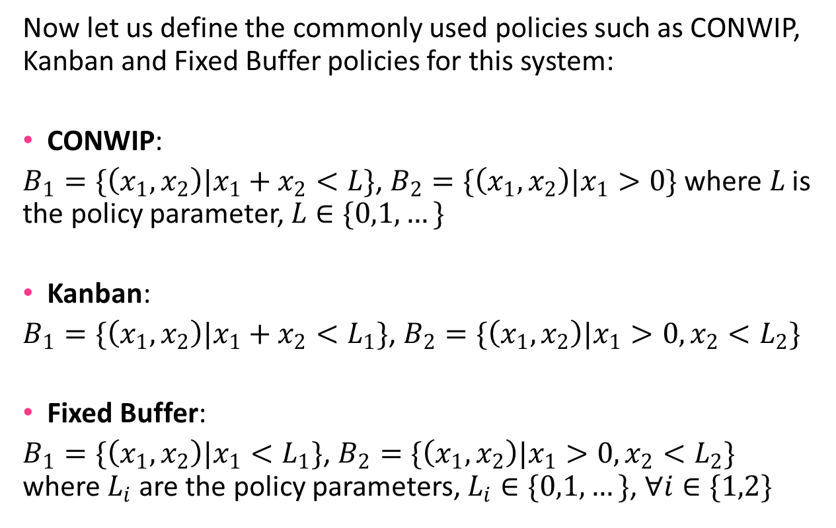
Numerical Experiments
Basic Model with No Rationing
Now let us define the commonly used policies such as CONWIP, Kanban and Fixed Buffer policies for this system:
CONWIP:
$B_{1}=\{\left(x_{1},x_{2}\right)|x_{1}+x_{2}<L\}$, $B_{2}=\{\left(x_{1},x_{2}\right)|x_{1}>0\}$ where $L$ is the policy parameter, $L∈\{0,1,…\}$
Kanban:
$B_{1}=\{\left(x_{1},x_{2}\right)|x_{1}+x_{2}<L_{1}\}$, $B_{2}=\{\left(x_{1},x_{2}\right)|x_{1}>0, x_{2}<L_{2}\}$
Fixed Buffer:
$B_{1}=\{\left(x_{1},x_{2}\right)|x_{1}<L_{1}\}$, $B_{2}=\{\left(x_{1},x_{2}\right)|x_{1}>0, x_{2}<L_{2}\}$ where $L_{i}$ are the policy parameters, $L_{i}∈\{0,1,…\}$, $∀i∈\{1,2\}$

Slide 25
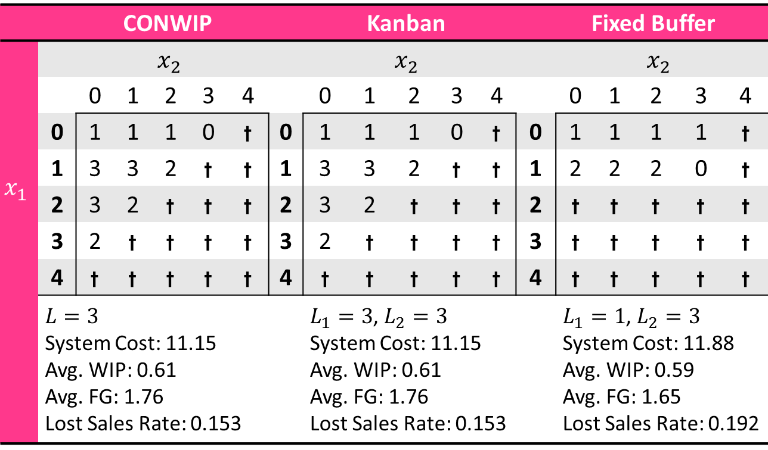
Numerical Experiments
Basic Model with No Rationing
$$x_{1}$$
$$x_{2}$$
S1
S2
WIP
FG
 | CONWIP |  |  |  |  |  | Kanban |  |  |  |  |  | Fixed Buffer
 |  | $$x_{2}$$ |  |  |  |  |  | $$x_{2}$$ |  |  |  |  |  | $$x_{2}$$
$$x_{1}$$ |  | 0 | 1 | 2 | 3 | 4 |  | 0 | 1 | 2 | 3 | 4 |  | 0 | 1 | 2 | 3 | 4
 | 0 | 1 | 1 | 1 | 0 | t | 0 | 1 | 1 | 1 | 0 | t | 0 | 1 | 1 | 1 | 1 | t
 | 1 | 3 | 3 | 2 | t | t | 1 | 3 | 3 | 2 | t | t | 1 | 2 | 2 | 2 | 0 | t
 | 2 | 3 | 2 | t | t | t | 2 | 3 | 2 | t | t | t | 2 | t | t | t | t | t
 | 3 | 2 | t | t | t | t | 3 | 2 | t | t | t | t | 3 | t | t | t | t | t
 | 4 | t | t | t | t | t | 4 | t | t | t | t | t | 4 | t | t | t | t | t
 | $L=3$ System Cost: 11.15 Avg. WIP: 0.61 Avg. FG: 1.76 Lost Sales Rate: 0.153 |  |  |  |  |  |  | $L_{1}=3$, $L_{2}=3$ System Cost: 11.15 Avg. WIP: 0.61 Avg. FG: 1.76 Lost Sales Rate: 0.153 |  |  |  |  |  | $L_{1}=1$, $L_{2}=3$ System Cost: 11.88 Avg. WIP: 0.59 Avg. FG: 1.65 Lost Sales Rate: 0.192

Slide 26
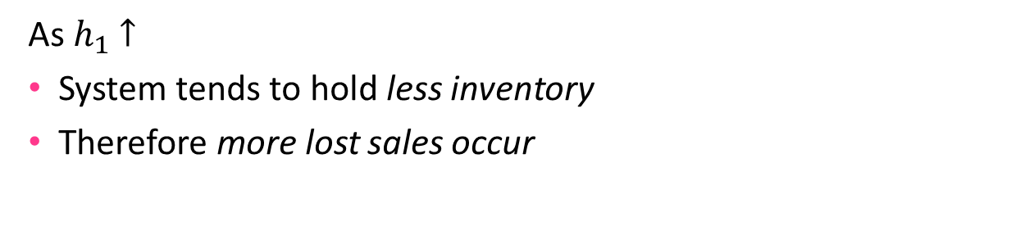
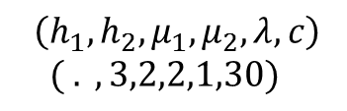


Numerical Experiments
Effects of holding cost changes
$$\left(h_{1},h_{2},μ_{1},μ_{2},λ,c\right)$$
$$( . ,3,2,2,1,30)$$
Cost of holding one unit of WIP inventory on hand $(h_{1})$
$$h_{1}$$
$$h_{1}$$
As $h_{1}$ $↑$
System tends to hold less inventory
Therefore more lost sales occur

Slide 27
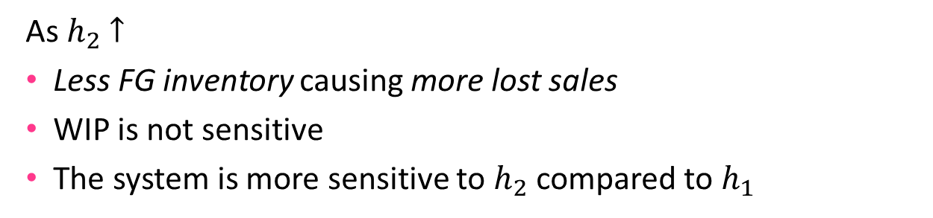
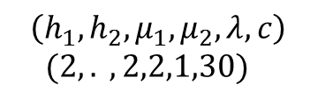


Numerical Experiments
Effects of the holding cost changes
$$\left(h_{1},h_{2},μ_{1},μ_{2},λ,c\right)$$
$$(2, . ,2,2,1,30)$$
The cost of holding one unit of FG inventory on hand ${(h}_{2})$
$$h_{2}$$
$$h_{2}$$
As $h_{2}$ $↑$
Less FG inventory causing more lost sales
WIP is not sensitive
The system is more sensitive to $h_{2}$compared to $h_{1}$

Slide 28
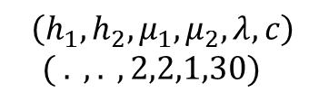
Numerical Experiments
Effects of the holding cost changes
$$\left(h_{1},h_{2},μ_{1},μ_{2},λ,c\right)$$
$$( . , . ,2,2,1,30)$$
Total system cost changes according to $h_{1}$ and $h_{2}$
FG inventory holding cost affects the total cost more than WIP does.

Slide 29
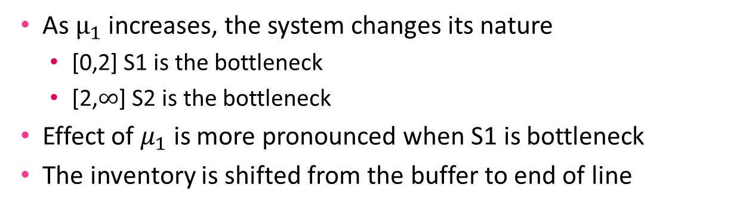
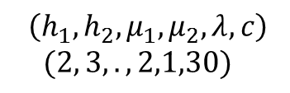


Numerical Experiments
Effects of the production rate changes
$$\left(h_{1},h_{2},μ_{1},μ_{2},λ,c\right)$$
$$(2, 3, . ,2,1,30)$$
The production rate of station 1 $(μ_{1})$
$$μ_{1}$$
$$μ_{1}$$
As $μ_{1}$ increases, the system changes its nature
  [0,2] S1 is the bottleneck
  [2,$∞$] S2 is the bottleneck
Effect of $μ_{1}$ is more pronounced when S1 is bottleneck
The inventory is shifted from the buffer to end of line

Slide 30
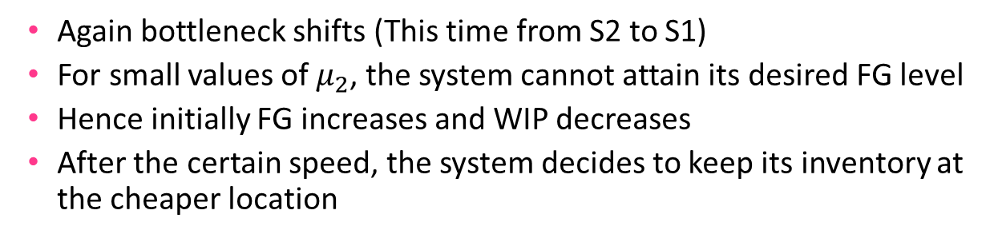
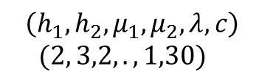


Numerical Experiments
Effects of the production rate changes
$$\left(h_{1},h_{2},μ_{1},μ_{2},λ,c\right)$$
$$(2, 3,2,.,1,30)$$
The production rate of station 1 ${(μ}_{2})$
$$μ_{2}$$
$$μ_{2}$$
Again bottleneck shifts (This time from S2 to S1)
For small values of $μ_{2}$, the system cannot attain its desired FG level
Hence initially FG increases and WIP decreases
After the certain speed, the system decides to keep its inventory at the cheaper location

Slide 31
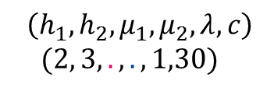
Numerical Experiments
Effects of the production rate changes
$$\left(h_{1},h_{2},μ_{1},μ_{2},λ,c\right)$$
$$(2, 3,.,.,1,30)$$
Total system cost changes according to $μ_{1}$ and $μ_{2}$
The system is more sensitive to the rate of S1
This is the opposite of what is observed with holding costs

Slide 32
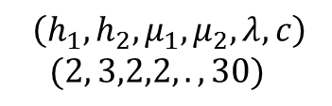


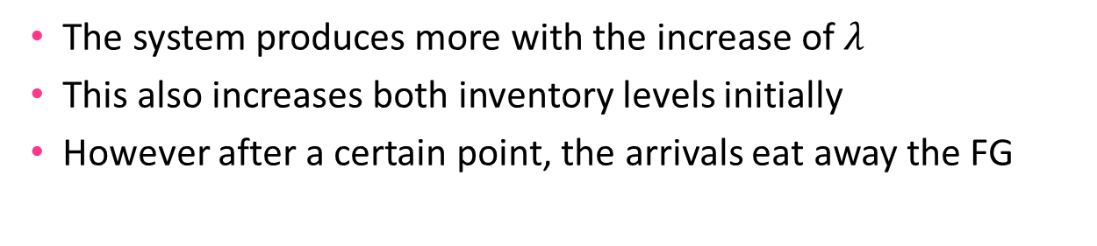
Numerical Experiments
Effects of the customer arrival rate
$$\left(h_{1},h_{2},μ_{1},μ_{2},λ,c\right)$$
$$(2, 3,2,2,.,30)$$
$$λ$$
$$λ$$
The system produces more with the increase of $λ$
This also increases both inventory levels initially
However after a certain point, the arrivals eat away the FG

Slide 33
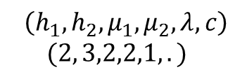

Numerical Experiments
Effects of the lost sales cost
$$\left(h_{1},h_{2},μ_{1},μ_{2},λ,c\right)$$
$$(2, 3,2,2,1,.)$$
$$c$$
$$c$$
As the value of a customer increases,
we observe less lost sales
in order to achieve this, both inventories increases

Slide 34
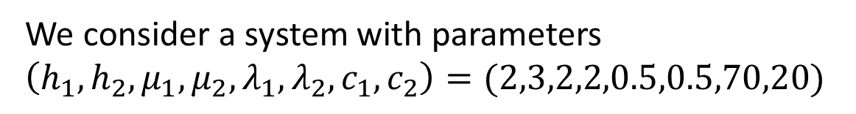
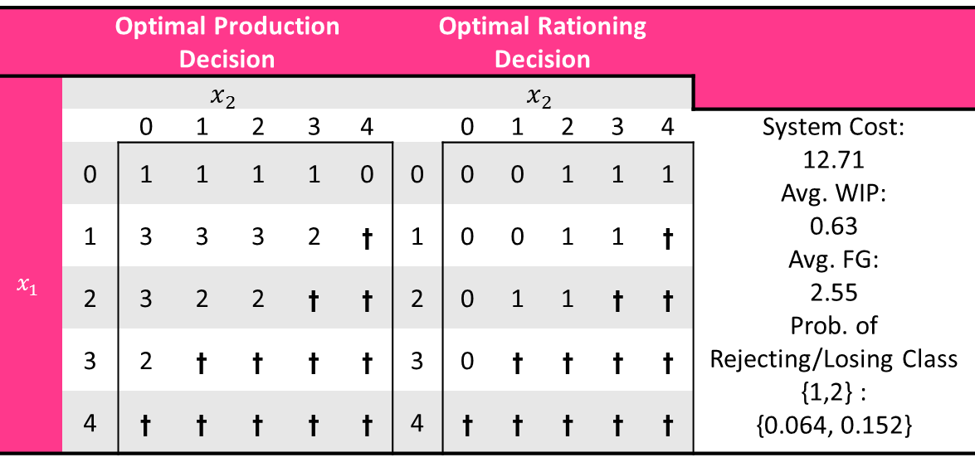
Numerical Experiments
Basic Model with 2 Customer Classes
$$x_{1}$$
$$x_{2}$$
S1
S2
WIP
FG
We consider a system with parameters
$$\left(h_{1},h_{2},μ_{1},μ_{2},λ_{1},λ_{2},c_{1},c_{2}\right)=(2,3,2,2,0.5,0.5,70,20)$$
 | Optimal Production Decision |  |  |  |  |  | Optimal Rationing Decision
 | $$x_{2}$$ |  |  |  |  |  | $$x_{2}$$
$$x_{1}$$ |  | 0 | 1 | 2 | 3 | 4 |  | 0 | 1 | 2 | 3 | 4 | System Cost: 12.71 Avg. WIP: 0.63 Avg. FG: 2.55 Prob. of Rejecting/Losing Class {1,2} : {0.064, 0.152}
 | 0 | 1 | 1 | 1 | 1 | 0 | 0 | 0 | 0 | 1 | 1 | 1
 | 1 | 3 | 3 | 3 | 2 | t | 1 | 0 | 0 | 1 | 1 | t
 | 2 | 3 | 2 | 2 | t | t | 2 | 0 | 1 | 1 | t | t
 | 3 | 2 | t | t | t | t | 3 | 0 | t | t | t | t
 | 4 | t | t | t | t | t | 4 | t | t | t | t | t

Slide 35
Numerical Experiments
Basic Model with 2 Customer Classes
The result of applying four production policies along with the static rationing (IL) policies
Policy | Best Rationing level | Optimal Policy Parameters | Avg. System Cost | Avg. WIP inventory level | Avg. FG inventory level | Prob. of Losing Class 1 Customer | Prob. of Losing/Rejecting Class 2 Customer
Optimal | 2 | - | 12.73 | 0.60 | 2.60 | 0.048 | 0.201
CONWIP | 2 | 4 | 12.81 | 0.68 | 2.64 | 0.046 | 0.192
Kanban | 2 | (4,4) | 12.81 | 0.68 | 2.64 | 0.046 | 0.192
Fixed Buffer | 2 | (2,3) | 13.48 | 1.42 | 2.20 | 0.050 | 0.225
CONWIP and Kanban policies are the same here
CONWIP and Kanban are considerably better compared to Fixed Buffer
They increase the inventory levels compared to the optimal

Slide 36
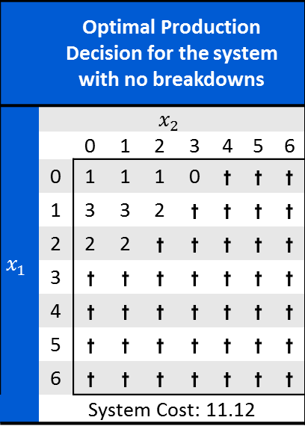
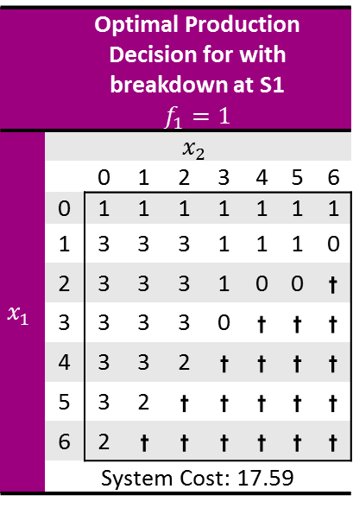



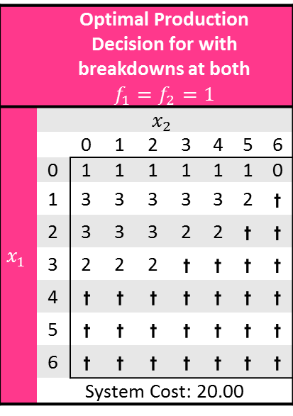
Numerical Experiments
Model with Breakdowns (no rationing)
$$x_{1}$$
$$x_{2}$$
S1
S2
WIP
FG
We consider a system with parameters $\left(h_{1},h_{2},μ_{1},μ_{2},λ,c,α_{1},α_{2},β_{1},β_{2}\right)$
$$(2,3,2,2,1,30,−,−,−,−)$$
$$(2,3,2,2,1,30,0.1,−,1,−)$$
$$(2,3,2,2,1,30,0.1,0.1,1,1)$$
 | Optimal Production Decision for the system with no breakdowns
 | $$x_{2}$$
$$x_{1}$$ |  | 0 | 1 | 2 | 3 | 4 | 5 | 6
 | 0 | 1 | 1 | 1 | 0 | t | t | t
 | 1 | 3 | 3 | 2 | t | t | t | t
 | 2 | 2 | 2 | t | t | t | t | t
 | 3 | t | t | t | t | t | t | t
 | 4 | t | t | t | t | t | t | t
 | 5 | t | t | t | t | t | t | t
 | 6 | t | t | t | t | t | t | t
 | System Cost: 11.12
 | Optimal Production Decision for with breakdown at S1 $$f_{1}=1$$
 | $$x_{2}$$
$$x_{1}$$ |  | 0 | 1 | 2 | 3 | 4 | 5 | 6
 | 0 | 1 | 1 | 1 | 1 | 1 | 1 | 1
 | 1 | 3 | 3 | 3 | 1 | 1 | 1 | 0
 | 2 | 3 | 3 | 3 | 1 | 0 | 0 | t
 | 3 | 3 | 3 | 3 | 0 | t | t | t
 | 4 | 3 | 3 | 2 | t | t | t | t
 | 5 | 3 | 2 | t | t | t | t | t
 | 6 | 2 | t | t | t | t | t | t
 | System Cost: 17.59
 | Optimal Production Decision for with breakdowns at both $$f_{1}=f_{2}=1$$
 | $$x_{2}$$
$$x_{1}$$ |  | 0 | 1 | 2 | 3 | 4 | 5 | 6
 | 0 | 1 | 1 | 1 | 1 | 1 | 1 | 0
 | 1 | 3 | 3 | 3 | 3 | 3 | 2 | t
 | 2 | 3 | 3 | 3 | 2 | 2 | t | t
 | 3 | 2 | 2 | 2 | t | t | t | t
 | 4 | t | t | t | t | t | t | t
 | 5 | t | t | t | t | t | t | t
 | 6 | t | t | t | t | t | t | t
 | System Cost: 20.00

Slide 37
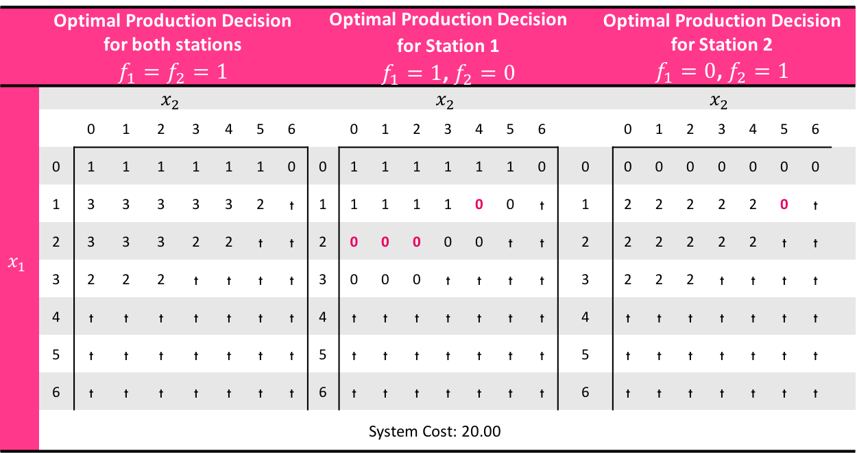

Numerical Experiments
Model with Breakdowns (no rationing)
$$x_{1}$$
$$x_{2}$$
S1
S2
WIP
FG
$$\left(h_{1},h_{2},μ_{1},μ_{2},λ,c,α_{1},α_{2},β_{1},β_{2}\right)=(2,3,2,2,1,30,0.1,0.1,1,1)$$
 | Optimal Production Decision for both stations $$f_{1}=f_{2}=1$$ |  |  |  |  |  |  |  | Optimal Production Decision for Station 1 $f_{1}=1$, $f_{2}=0$ |  |  |  |  |  |  |  |  | Optimal Production Decision for Station 2 $f_{1}=0$, $f_{2}=1$
 | $$x_{2}$$ |  |  |  |  |  |  |  | $$x_{2}$$ |  |  |  |  |  |  |  |  | $$x_{2}$$
$$x_{1}$$ |  | 0 | 1 | 2 | 3 | 4 | 5 | 6 |  | 0 | 1 | 2 | 3 | 4 | 5 | 6 |  |  | 0 | 1 | 2 | 3 | 4 | 5 | 6
 | 0 | 1 | 1 | 1 | 1 | 1 | 1 | 0 | 0 | 1 | 1 | 1 | 1 | 1 | 1 | 0 | 0 |  | 0 | 0 | 0 | 0 | 0 | 0 | 0
 | 1 | 3 | 3 | 3 | 3 | 3 | 2 | t | 1 | 1 | 1 | 1 | 1 | 0 | 0 | t | 1 |  | 2 | 2 | 2 | 2 | 2 | 0 | t
 | 2 | 3 | 3 | 3 | 2 | 2 | t | t | 2 | 0 | 0 | 0 | 0 | 0 | t | t | 2 |  | 2 | 2 | 2 | 2 | 2 | t | t
 | 3 | 2 | 2 | 2 | t | t | t | t | 3 | 0 | 0 | 0 | t | t | t | t | 3 |  | 2 | 2 | 2 | t | t | t | t
 | 4 | t | t | t | t | t | t | t | 4 | t | t | t | t | t | t | t | 4 |  | t | t | t | t | t | t | t
 | 5 | t | t | t | t | t | t | t | 5 | t | t | t | t | t | t | t | 5 |  | t | t | t | t | t | t | t
 | 6 | t | t | t | t | t | t | t | 6 | t | t | t | t | t | t | t | 6 |  | t | t | t | t | t | t | t
 | System Cost: 20.00
As the other station breaksdown, the operating one starts to produce less.

Slide 38
Future Works
Longer tandem lines (5 stations) in order to investigate the buffer allocation problem from an optimal control perspective
Adaptation to throughput maximization perspective (push) instead of demand satisfaction perspective (pull)
Theoretical characterization of policies

